Slide 1
Advanced Industrial Design Engineering
GRAP2575
Lecturers: Nick Johns & Rick Butcher

Slide 2
Engineering Autopsy
State your name
State your autopsy product title
Stop frame animation: 2 minutes
High resolution image
Review summary & comments: 1-2 minutes

Slide 3
Sustainability

Slide 4
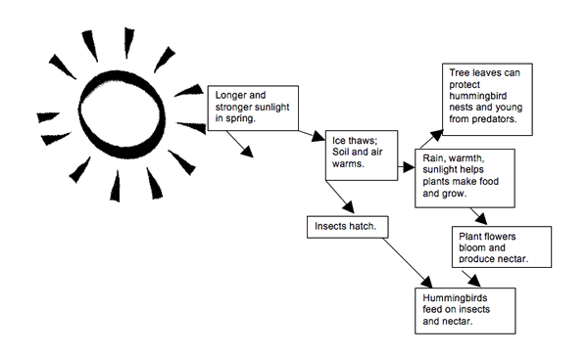
Sustainability

Slide 5
Week #5 – Sustainability analysis
Product Sustainability Analysis
Undertake a qualitative analysis of your product based on sustainable design principles
material selection
manufacturing processes
assembly / disassembly
Format PDF document with annotated images/sketches.
Task beyond class
Complete the qualitative analysis based on the format required for submission.
Source a product that you consider to be a good sustainable design and a product that is a poor sustainable design.
To be uploaded onto myRMIT before the next class and/or to bring into class week six. Read Material profiles introduction (Edn.2: p.196 - 204) (Edn.3: p.243 - 254)

Slide 6
Qualitative sustainability evaluation

Slide 7
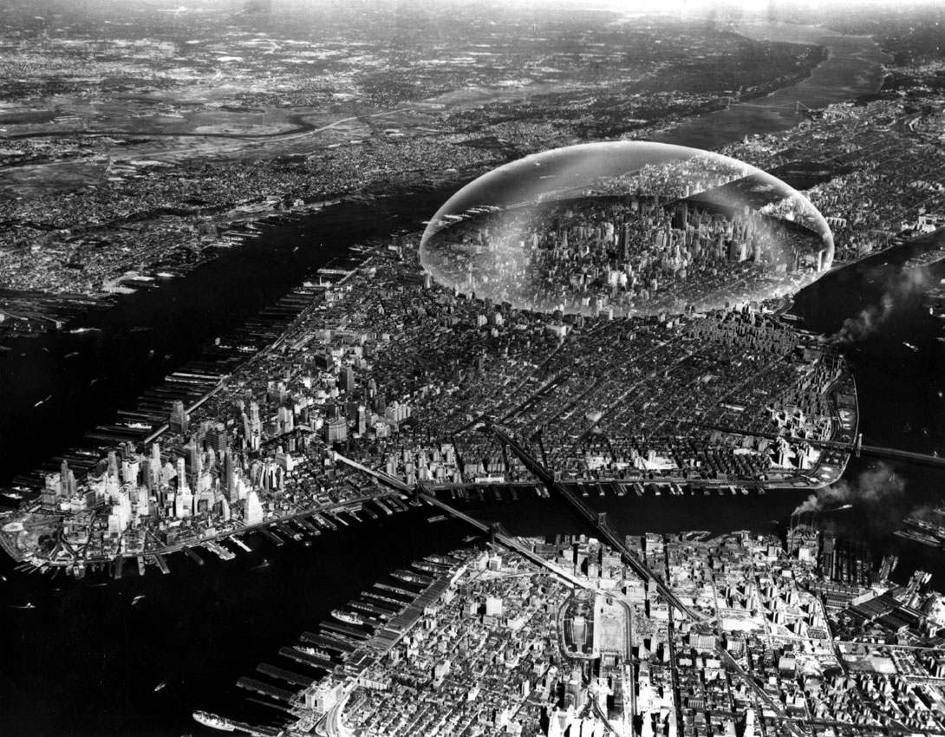
Richard Buckminster Fuller

Slide 8
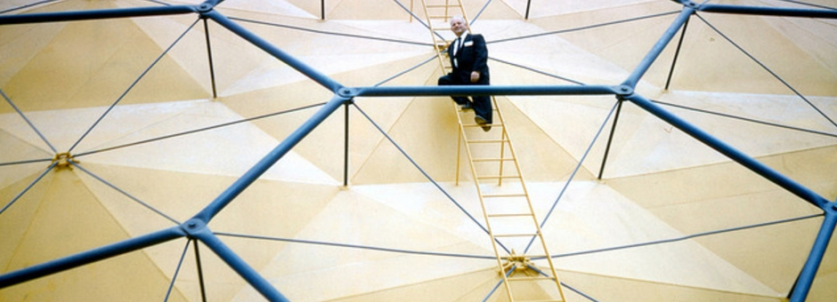
Richard Buckminster Fuller
R. Buckminster Fuller was one of the first designers to advocate a sustainable, inclusive approach to design back in the 1920s.
He developed ideas around ‘Ephemeralisation’ - humanity learning to do more with less.

Slide 9
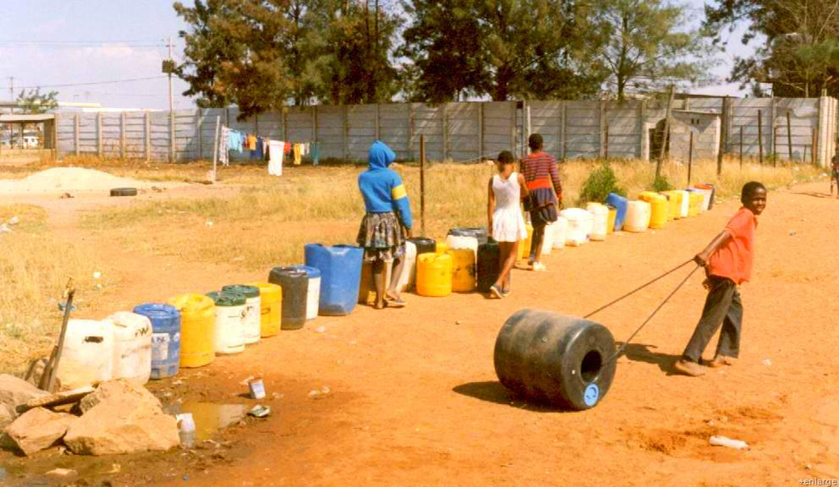
Victor Papanek
Victor Papanek published ‘Design for the Real World: Human Ecology and Social Change’ back in 1971.

Slide 10
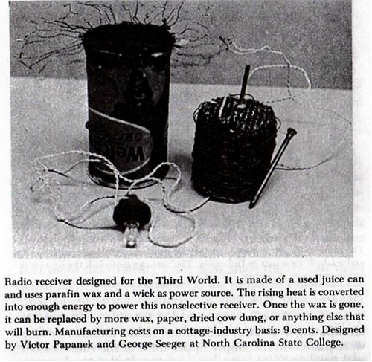
Victor Papanek
His work included sustainable ideas including:
An educational TV set that could be utilized in Africa and produced in Japan for $9.00 per set (cost in 1970 dollars).
A transistor radio made from ordinary metal food cans and powered by a burning candle.

Slide 11
Articulating ‘sustainability’
Sustainability is an ‘umbrella’ term used for many purposes & articulated in many different ways.
Depending on the stakeholders, their ambitions & their audiences
Sustainable terminology might refer to simple ideas such as
‘pollution free’
‘creating local employment’
‘being renewable’, etc

Slide 12
Sustainability in the media
Complex terms are not easy to communicate.
Over-simplification of concepts is common.
This reinforces public perceptions & increases the difficulties in seeing the whole picture of ‘hidden’ articulations.
To not aggravate other problems while trying to fix one, it’s important to keep a clear vision of all aspects of sustainable development when addressing specific problems…

Slide 13
Paradoxes of sustainability
More efficient technologies might boost consumption and thereby contribute to resource depletion instead of saving resources.
That prescribing technologies with less harmful side effects might lead to a transfer of production or illegal use, thereby aggravating problems.

Slide 14
An ecology of sustainability
A cyclical rather than linear model of the production system is the dominant paradigm.
Akin to the cycle of seasons – recognizing production systems as natural ecologies.
The boundaries defining the production eco-system are fractal and multi-dimensional.
Influenced by degrees of complexity at multiple levels.
Sustainable outcomes, then, can be described in terms of various systems.

Slide 15
Open systems

Slide 16
The visualization of systems
Frank Havermans

Slide 17
The interpretation of systems
Frank Havermans TOFUD explorations of systems. (Temporary Office For Urban Development)
Starting with a situation that is undergoing development, it creates a completely different picture for the future. It looks at how a particular city district could grow in a situation where spatial conditions are not delimited by financial and political considerations.
How might discussion at varying scales affect design iterations for sustainable materials & processes systems?

Slide 18
The visualization of systems
Frank Havermans

Slide 19
Exposing the system schema
Demonstrating energy flows through systems
The second law of thermodynamics
Heat will not flow from a cold to a hot object spontaneously
The thermodynamics of a system can be discussed as a measure of disorder within a system.
Open & closed systems evolve differently toward states of maximum entropy.
An open system is more complex & less quantifiable.
Illustrating system characteristics is a significant sustainability endeavour.

Slide 20
System boundaries
Gerrit Rietveld created three-dimensional realizations of geometric forms that do not so much delimit as contain and activate the human body – and mind.
Low Tech Factory is a project by ECAL / University of Art and Design in Lausanne, Switzerland. Image courtesy Studio Droog

Slide 21
System boundaries
Better Place Unveils an Electric Car Battery Swap Station.
The revolutionary system infrastructure roll-out ultimately proved too much for Better Place founder and CEO Shai Agassi.
The automotive industry was reluctant to get on board with standards.
Image courtesy Wired.com

Slide 22
Sustainable innovation
‘The New Original’ - Aiming to raise discourse on the future of design, Droog Lab went to Shenzhen, China, the epicentre of copycat culture, with the intent of copying China.
Teapot with handle by Richard Hutten - Image courtesy Studio Droog

Slide 23
The new originality
The shapes of the vases are merely taken from what an archetype vase would look like. The copied colours were taken digitally. The designer took this information and translated it into 3D, applying the gradients to the 3D models and then directly 3D printed these colours.
Image courtesy Studio Droog

Slide 24
Emerging systems

Slide 25
Emerging systems

Slide 26
Emerging production systems
‘Low tech factory’: Rocking-knit
How will materials & processes evolve over time?
Image courtesy Studio Droog
ECAL Low-Tech Factory
http://vimeo.com/52597191

Slide 27
Water footprint
ISO created working group WG 8, Water footprint, within technical committee ISO/TC 207, Life cycle assessment. The WG is developing ISO 14046, Environmental management - Water footprint - Principles, requirements and guidelines, expected to be published by mid 2014.

Slide 28
Water footprint

Slide 29
Product Life Cycle

Slide 30
Phase of life analysis

Slide 31
The goals for material efficiency
Increased material efficiency is to accommodate the material consumption required for necessary goods & services while producing as little material as possible.
Minimize depletion of non-renewable materials.
Reduce dependence of developed countries on imports, particularly those in short supply.
Reduce demand on other resources (energy).
Reduce unwanted emissions.

Slide 32
Strategies for material efficiency
Four broad strategies are available
Improved material technologies.
Material efficient engineering design.
The use of economic instruments (price, taxes…).
Social adaptation & change of lifestyle.

Slide 33
Re-engineering & life extension
Often services which trade in maintenance of a product as a service, such as
Office equipment
Vehicle parts
Infrastructure like PT
What are some ‘end-of-life’ options you have experienced?

Slide 34
Re-engineering & life extension

Slide 35
Why do we throw things away?
Physical lifespan
Function lifespan
Obsolescence
Economic lifespan
Legal lifespan
Fashion & taste
Extending a product’s lifespan requires extending all of the above!

Slide 36
Why do we throw things away?

Slide 37
Embodied energy & market value
The cost of recycling polymers is high and the price they command is low, resulting in the fractional contribution of recycled polymers to current consumption. For metals, the contribution is large; for polymers, small (2005 data).
Courtesy Materials Engineering Science – Processing and Design

Slide 38
Re-use & recycling
Recycling of metals is far more prevalent than that of polymers.
Polymers are difficult to identify due to their density, fillers & electrical properties.
Re-cycle marks make this possible
The value of recycled polymers is typically lower than virgin plastics – discouraging use.
What new methods might we propose?

Slide 39
Re-use & recycling

Slide 40
Designing with recycled materials
Simple guidelines for polymer recycling
Reduced strength needs thicker wall sections
Applications where colour is not critical
Specify easily recycled materials
Minimize the number of different polymers
Select mutually compatible groups
Avoid laminates, retardants, fillers, reinforcing fibres & stickers

Slide 41
Energy consumption
The Kyoto Protocol of 1997 committed the developed nations to progressively reduce carbon emissions, meaning CO².
At the national level the focus is more on reducing energy consumption, but since this and CO² production are closely related, they are nearly equivalent.
Thus, there is a certain logic in basing design decisions on energy consumption or CO² generation.

Slide 42
Embodied energy & CO² footprint
The embodied energy of a material is the energy that must be committed to create 1kg of usable material—1kg of steel stock, or of PET pellets, or of cement powder, for example, measured in MJ/kg.
The CO² footprint is the associated release of CO², in kg/kg.

Slide 43
Embodied energy
An input–output diagram for PET production (giving the embodied energy/kg of PET) and for bottle production (giving the embodied energy/bottle).
Courtesy Materials Engineering Science – Processing and Design

Slide 44
Embodied energy
A simpliﬁed input–output diagram for the recycling of plastics to recover PET, and its use to make lower-grade products such as ﬂeece.
Courtesy Materials Engineering Science – Processing and Design

Slide 45
Embodied energy by unit volume

Slide 46
Embodied energy by overall usage

Slide 47
Embodied energy & flexibility
Figures 20.10 and 20.11 are a pair of materials selection charts for minimizing energy H_{m} per unit stiffness and strength. This chart shows modulus E plotted against H_{m} - the guidelines give the slopes for three of the commonest performance indices.
Courtesy Materials Engineering Science – Processing and Design

Slide 48
Embodied energy & strength
Figures 20.10 and 20.11 are a pair of materials selection charts for minimizing energy H_{m} per unit stiffness and strength. This chart shows modulus E plotted against H_{m} - the guidelines give the slopes for three of the commonest performance indices.
Courtesy Materials Engineering Science – Processing and Design

Slide 49
What about packaging?
Packaging is a necessary part of the product equation, particularly for
Protection
Information
Affiliation
Status
Presentation
What good & bad packaging examples come to mind?

Slide 50
What about packaging?

Slide 51
What about packaging?

Slide 52
…and Bio-polymers?
Currently the largest user of bio-polymers is the packaging industry.
Problems associated with bio-polymers
The biggest problem is the land area required to grow bio-polymeric substrates
Costly compared with oil based polymers

Slide 53
…and Bio-polymers?
This set is made of 100% sugar!
Made from PLA (Poly Lactid Acid) but 100% biodegradable and 100% natural.
Just Sugar is dishwasher and microwave safe too.

Slide 54
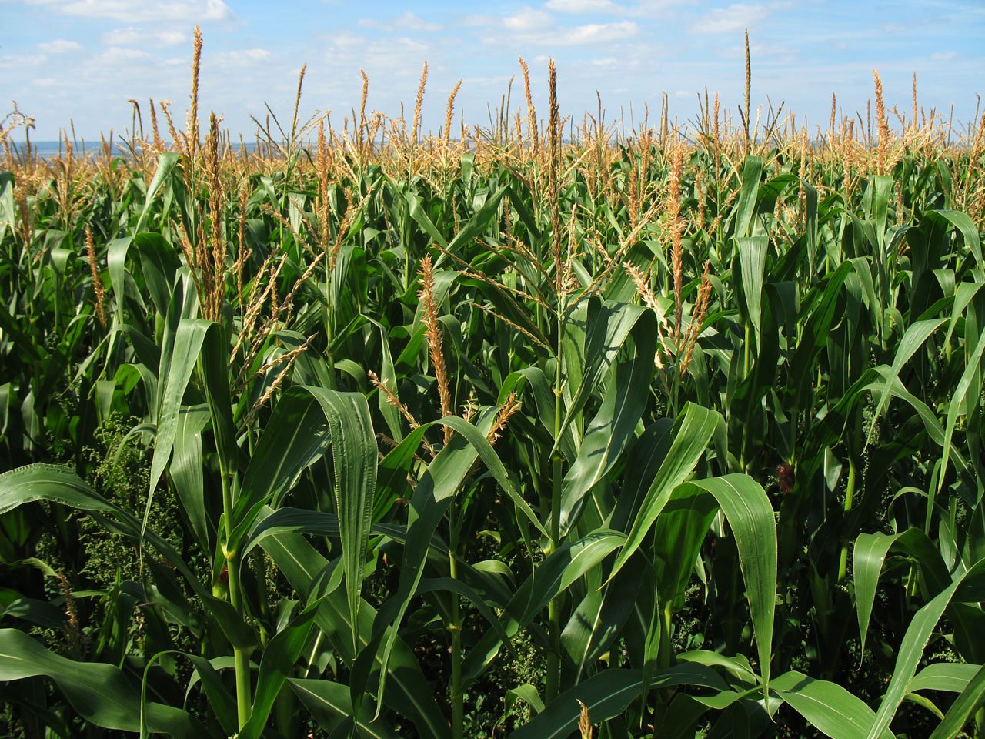
Polylactic acid (PLA)
The most common bioplastic in use today.
Corn or other raw materials are fermented to produce lactic acid, which is then polymerized to make polylactic acid(PLA).
Bioplastics are expected to make major contributions to environmental protection, because they reduce CO2 and because they are biodegradable.
The range of applications for bioplastics is growing, from materials used in automobile interiors to packaging for foods and cosmetics, to agricultural sheeting, to household appliances. (Hitachi)
Where do bio-polymers come from?
What are the implications of specifying bio-polymers for mass production?

Slide 55
Qualitative sustainability evaluation

Slide 56
Qualitative sustainability evaluation

Slide 57
Assignment 2: Sustainability case study
Consider & discuss the sustainable (or unsustainable) manufacture of your product autopsy components
Refer to the Brief, Deliverables and grading here.
Map results to comparative diagrams.
This assignment will require you to document your design development and outcomes through the preparation of an A4 landscape digital PDF portfolio or html document.
Duration: weeks 6-9
Weekly discourse: You will present your work each week through a variety of methods including verbal presentations.
Final presentation of assessment task two will be in Week 10.

Slide 58
Assignment 2: Sustainability case study
Assessment Weighting: 30% of overall course grade.
Formats for submission:
An A4 landscape pdf or html portfolio that shows your developmental discussions.
Save your portfolio in the following format and naming convention: Lastname_Firstname_GRAP2575_Assignment2.pdf
Submit to MyRMIT Wiki by 9am, Week 10

Slide 59
Week #5 – Homework
Product Sustainability Analysis
Undertake a qualitative analysis of your product based on sustainable design principles
material selection
manufacturing processes
assembly / disassembly
Format PDF document with annotated images/sketches.
Task beyond class
Complete the qualitative analysis based on the format required for submission.
Source a product that you consider to be a good sustainable design and a product that is a poor sustainable design.
To be uploaded onto myRMIT before the next class and/or to bring into class week six. Read Material profiles introduction (Edn.2: p.196 - 204) (Edn.3: p.243 - 254)

Slide 60
Homework
Blackboard interaction is necessary to remain in touch
Log in at least once a week
Check messages
Upload content of interest to group
Start collaborating

